Slide 1


SAP S/4HANA Training
MASTER DATA GOVERNANCE (SAP MDG)
Neeraj Gupta
Session 15
SAP MDG – RBW Workflow Enhancement

Slide 2
15
SAP MDG – Using Rule Based Workflow (WS60800086)
Rule Based Workflow Template (WS60800086)

Slide 3
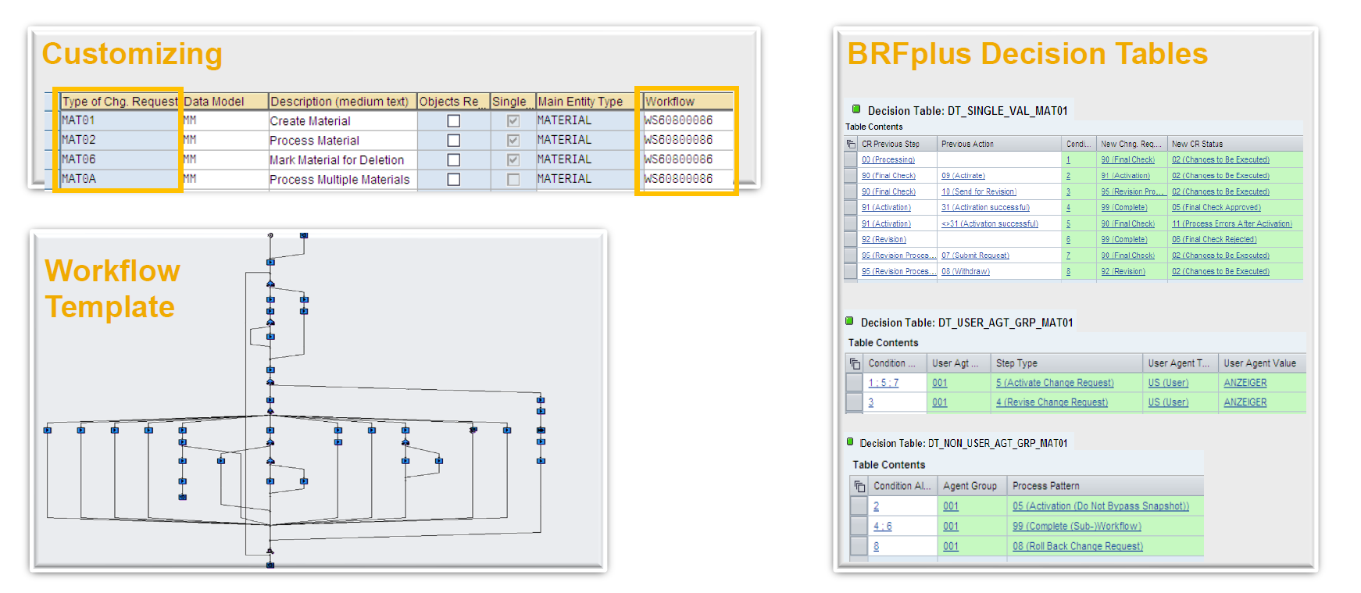
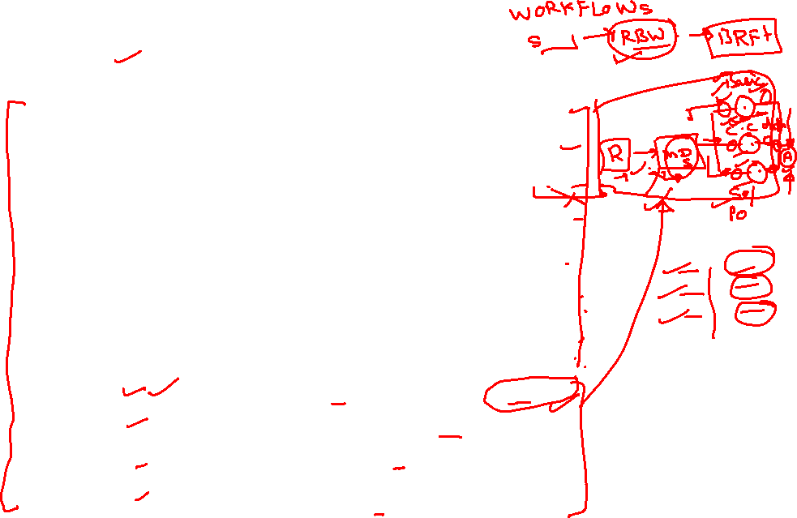
Rule Based Workflow Components
15
SAP MDG – Workflow Process Modelling

Slide 4
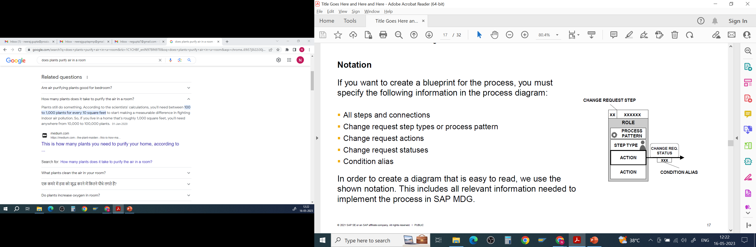
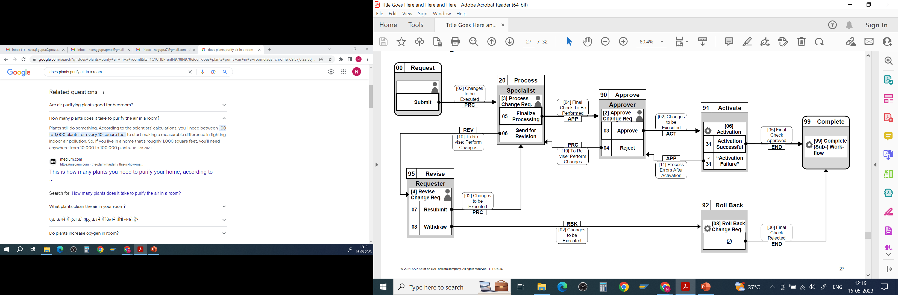
15
SAP MDG – Using Rule Based Workflow (WS60800086)
Process Diagram for Change Request Process

Slide 5
15
SAP MDG – Using Rule Based Workflow (WS60800086)
Business add-ins: (RBW) BAdI USMD_SSW_RULE_CONTEXT_PREPARE method PREPARE_RULE_CONTEXT Scenario: The function of this rule context BAdI is to route that CR at a certain step to specific user/group/role
Create a Change Request Procedure

Slide 6
15
SAP MDG – Using Rule Based Workflow (WS60800086)
Business add-ins: (RBW) BAdI USMD_SSW_RULE_CONTEXT_PREPARE method PREPARE_RULE_CONTEXT Scenario: The function of this rule context BAdI is to route that CR at a certain step to specific user/group/role
Create a Change Request Procedure

Slide 7
Business add-ins: (RBW) BAdI USMD_SSW_RULE_CONTEXT_PREPARE method PREPARE_RULE_CONTEXT Scenario: The function of this rule context BAdI is to route that CR at a certain step to specific user/group/role
15
SAP MDG – Using Rule Based Workflow (WS60800086)
Define Service

Slide 8
Business add-ins: (RBW) BAdI USMD_SSW_RULE_CONTEXT_PREPARE method PREPARE_RULE_CONTEXT Scenario: The function of this rule context BAdI is to route that CR at a certain step to specific user/group/role
15
SAP MDG – Using Rule Based Workflow (WS60800086)
Create Enhancement Implementation

Slide 9
Business add-ins: (RBW) BAdI USMD_SSW_RULE_CONTEXT_PREPARE method PREPARE_RULE_CONTEXT Scenario: The function of this rule context BAdI is to route that CR at a certain step to specific user/group/role
15
SAP MDG – Using Rule Based Workflow (WS60800086)
BAdI definition USMD_SSW_RULE_CONTEXT_PREPARE

Slide 10
Business add-ins: (RBW) BAdI USMD_SSW_RULE_CONTEXT_PREPARE method PREPARE_RULE_CONTEXT Scenario: The function of this rule context BAdI is to route that CR at a certain step to specific user/group/role
15
SAP MDG – Using Rule Based Workflow (WS60800086)
Create BAdI Implementation (Select MDG_BS_MAT_BRF_CONTEXT_LABOR)

Slide 11
Business add-ins: (RBW) BAdI USMD_SSW_RULE_CONTEXT_PREPARE method PREPARE_RULE_CONTEXT Scenario: The function of this rule context BAdI is to route that CR at a certain step to specific user/group/role
15
SAP MDG – Using Rule Based Workflow (WS60800086)
Create BAdI Implementation (Select MDG_BS_MAT_BRF_CONTEXT_LABOR)

Slide 12
Business add-ins: (RBW) BAdI USMD_SSW_RULE_CONTEXT_PREPARE method PREPARE_RULE_CONTEXT Scenario: The function of this rule context BAdI is to route that CR at a certain step to specific user/group/role
15
SAP MDG – Using Rule Based Workflow (WS60800086)
Enhancement Implementation MDG_BS_MAT_BRF_CONTEXT_LABOR and choose Copy Sample Class

Slide 13
Business add-ins: (RBW) BAdI USMD_SSW_RULE_CONTEXT_PREPARE method PREPARE_RULE_CONTEXT Scenario: The function of this rule context BAdI is to route that CR at a certain step to specific user/group/role
15
SAP MDG – Using Rule Based Workflow (WS60800086)
Implementing Class and open the IF_USMD_SSW_RULE_CNTX_PREPARE method

Slide 14
Business add-ins: (RBW) BAdI USMD_SSW_RULE_CONTEXT_PREPARE method PREPARE_RULE_CONTEXT Scenario: The function of this rule context BAdI is to route that CR at a certain step to specific user/group/role
15
SAP MDG – Using Rule Based Workflow (WS60800086)
code for the BAdI

Slide 15
Business add-ins: (RBW) BAdI USMD_SSW_RULE_CONTEXT_PREPARE method PREPARE_RULE_CONTEXT Scenario: The function of this rule context BAdI is to route that CR at a certain step to specific user/group/role
15
SAP MDG – Using Rule Based Workflow (WS60800086)
Create Filter

Slide 16
Business add-ins: (RBW) BAdI USMD_SSW_RULE_CONTEXT_PREPARE method PREPARE_RULE_CONTEXT Scenario: The function of this rule context BAdI is to route that CR at a certain step to specific user/group/role
15
SAP MDG – Using Rule Based Workflow (WS60800086)
transaction USMD_SSW_RULE

Slide 17
Business add-ins: (RBW) BAdI USMD_SSW_RULE_CONTEXT_PREPARE method PREPARE_RULE_CONTEXT Scenario: The function of this rule context BAdI is to route that CR at a certain step to specific user/group/role
15
SAP MDG – Using Rule Based Workflow (WS60800086)
create the LABOR field. Go to BRF+ Application → CR-Type Related Application

Slide 18
Business add-ins: (RBW) BAdI USMD_SSW_RULE_CONTEXT_PREPARE method PREPARE_RULE_CONTEXT Scenario: The function of this rule context BAdI is to route that CR at a certain step to specific user/group/role
15
SAP MDG – Using Rule Based Workflow (WS60800086)
Set Binding Type to Bind to… DDIC Element to LABOR >> Create

Slide 19
Business add-ins: (RBW) BAdI USMD_SSW_RULE_CONTEXT_PREPARE method PREPARE_RULE_CONTEXT Scenario: The function of this rule context BAdI is to route that CR at a certain step to specific user/group/role
15
SAP MDG – Using Rule Based Workflow (WS60800086)
Trigger Function and select Function to Call Ruleset >> Add Existing Data Object.

Slide 20
Business add-ins: (RBW) BAdI USMD_SSW_RULE_CONTEXT_PREPARE method PREPARE_RULE_CONTEXT Scenario: The function of this rule context BAdI is to route that CR at a certain step to specific user/group/role
15
SAP MDG – Using Rule Based Workflow (WS60800086)
Choose Name is equal to LABOR

Slide 21
Business add-ins: (RBW) BAdI USMD_SSW_RULE_CONTEXT_PREPARE method PREPARE_RULE_CONTEXT Scenario: The function of this rule context BAdI is to route that CR at a certain step to specific user/group/role
15
SAP MDG – Using Rule Based Workflow (WS60800086)
User agent table must be altered to contain Laboratory
Insert Column → From Context Data Objects

Slide 22
Business add-ins: (RBW) BAdI USMD_SSW_RULE_CONTEXT_PREPARE method PREPARE_RULE_CONTEXT Scenario: The function of this rule context BAdI is to route that CR at a certain step to specific user/group/role
15
SAP MDG – Using Rule Based Workflow (WS60800086)
User agent table must be altered to contain Laboratory
Insert Column → From Context Data Objects

Slide 23
Business add-ins: (RBW) BAdI USMD_SSW_RULE_CONTEXT_PREPARE method PREPARE_RULE_CONTEXT Scenario: The function of this rule context BAdI is to route that CR at a certain step to specific user/group/role
15
SAP MDG – Using Rule Based Workflow (WS60800086)
Modify the user decision table. Creating conditions for Labs 001, 002, E1, E2 and E3

Slide 24
Business add-ins: (RBW) BAdI USMD_SSW_RULE_CONTEXT_PREPARE method PREPARE_RULE_CONTEXT Scenario: The function of this rule context BAdI is to route that CR at a certain step to specific user/group/role
15
SAP MDG – Using Rule Based Workflow (WS60800086)
User Agent Type to US

Slide 25
Business add-ins: (RBW) BAdI USMD_SSW_RULE_CONTEXT_PREPARE method PREPARE_RULE_CONTEXT Scenario: The function of this rule context BAdI is to route that CR at a certain step to specific user/group/role
15
SAP MDG – Using Rule Based Workflow (WS60800086)
Add the service name >> CR-Type Related Service Name and choose Set Service Name.

Slide 26
Business add-ins: (RBW) BAdI USMD_SSW_RULE_CONTEXT_PREPARE method PREPARE_RULE_CONTEXT Scenario: The function of this rule context BAdI is to route that CR at a certain step to specific user/group/role
15
SAP MDG – Using Rule Based Workflow (WS60800086)
Testing >> CR Type >> Lab / Office >> Processor selection.

Slide 27
Business add-ins: (RBW) BAdI USMD_SSW_RULE_CONTEXT_PREPARE method PREPARE_RULE_CONTEXT Scenario: The function of this rule context BAdI is to route that CR at a certain step to specific user/group/role
15
SAP MDG – Using Rule Based Workflow (WS60800086)
After submitting, the system will push this request to the designated processor in the workflow as the lab value

Slide 28

End of Session15

Slide 29

Questions

Slide 30

Neeraj gupta

Slide 31


We’re committed to empower you to be
Most Desirable Resource
through powerful training solutions.
We build the workforce of the future.
250+
Corporate Clients
30,000+
Learners Trained
25000+
Learners Placed
FREE WEBINARS
Sign up for free webinars with industry experts every fortnight!
Enroll Now!
Contact us today!
https://anubhavtrainings.com/

Slide 32




More from AnubhavTrainings.com

